Slide 1
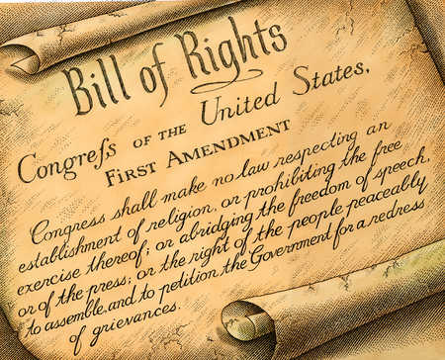
Student Rights: The First Amendment and the Dress Code
Photo Credit: [Bill of Rights] Western Journalism retrieved on 10/21/2014 from http://www.westernjournalism.com/wp-content/uploads/2012/03/first-amendment47258.jpg
Taylor Johnson

Slide 2
The First Amendment
Congress shall make no law respecting an establishment of religion, or prohibiting the free exercise thereof; or abridging the freedom of speech, or of the press; or the right of the people peaceably to assemble, and to petition the government for a redress of grievances.
The First Amendment is a part of the Bill of Rights, the first ten amendments added to the Constitution of the United States of America.
It “guarantees” the freedom of “religion, expression, assembly, and the right to petition” (First …, 2014).

Slide 3
The First Amendment Explained
Religion
“prohibits the government from passing legislation to establish an official religion or preferring one religion over another” (First…, 2014)
This means the “separation of church and state” (First…, 2014)
Congress cannot interfere with the practices of religion
Expression: Speech and Press
“freedom of speech allows individuals to express themselves without interference or constraint by the government” (First…, 2014)
However, the government “may prohibit some speech that may cause a breach of the peace or cause violence” (First…, 2014)
Freedom of the Press “allows an individual to express themselves through publication and dissemination” (First…, 2014)
Assembly
“the right to assemble allows people to gather for peaceful and lawful purposes” (First…, 2014)
Petition the Government
The “right to petition the government for a redress of grievances guarantees people the right to ask the government to provide relief for a wrong through the courts or other government action” (First…, 2014)

Slide 4
The history
Originally, when the Bill of Rights was first written in 1791, the First Amendment only applied to Congress and the federal government.
Therefore, the free speech of students attending public schools was “restricted” until well into the “20th Century” (Does…, 2014)
It wasn’t until 1943 in the West Virginia v. Barnette that the Supreme Court ruled that the First Amendment included public schools (Does…, 2014).
“Justice Robert Jackson said that the Supreme Court must ensure ‘scrupulous protection of constitutional freedoms of the individual, if we are not to strangle the free mind at its source and teach youth to discount important principles of our government as mere platitudes.’” (Does…, 2014)

Slide 5
Further lawsuits that define the amendment
In 1919, in the court case Schenck v. United States, it was determined that Freedom of Expression does not include words aimed to “create a clear and present danger”. However, this can be a very subjective aspect which depends on the “proximity and degree”. In Bradenburg v. Ohio (1969), this was further elaborated as speech that is aimed to create “imminent lawless action” (Notable…, 2014)
In Tinker v. Des Moines Independent Community School District (1969), it was decided that students’ have the right to “express political and social views” while at school (Notable…, 2014)
In Minarcini v. Strongsville (1976), it was decided that removing certain books from a school library was unconstitutional because it is the “students’ First Amendment right to receive information and the librarian’s right to disseminate it” (Notable…). In a much more recent case, Counts v. Cedarville School District (2003), the courts upheld the “students’ First Amendment right to read and receive information” by allowing students to read the Harry Potter books without getting a permission slip signed by their parents (Notable…, 2014).
However, in Hazelwood School District v. Kuhlmeier (1988), the Supreme Court decided that a school may limit speech that is “inconsistent with its ‘basic educational mission’”, especially if the speech/writing took place in a class and not in a public forum. Furthermore, in Romano v. Harrington (1989) it was decided that “educators may exercise greater editorial control over what students write for class than what they voluntarily submit to extracurricular publications” (Notable…, 2014)
In West Virginia v. Barnette (1943), it was also decided that the “First Amendment barred any rule compelling an individual to salute the flag or participate in the Pledge of Allegiance” (Notable…, 2014)

Slide 6
Differences for Minors?
In Ginsberg v. New York (1968), the Supreme Court decided that placing age restrictions on the purchase of sexually explicit materials did NOT violate minors First Amendment rights (Notable…, 2014)
In New York v. Ferber (1982) it was determined that the First Amendment does NOT protect child pornography, “obscenity, defamation, incitement, and “fighting words” (Notable…, 2014)

Slide 7
What does this mean for you?
AS A TEACHER YOU:
-cannot promote one religion over another
-cannot limit the practice of any religion
-cannot limit the expression of students political and social views
Exception: teacher may practice greater editorial control in their own classroom assignments than in voluntary public forums
-cannot limit or restrict access to books/literature
-cannot force your students to salute the flag or say the Pledge of Allegiance
-cannot limit the students’ from assembling peacefully
AS A STUDENT YOU:
-cannot participate or incite in public speech aimed to create violence
-can express your political and social views at school
Exception: this cannot include child pornography, obscene language, defamation, incitement, or fighting words
-can receive information through all books without restrictions or bans
Exception: this does not include sexually explicit material for minors
-are not required to participate in saluting the flag or saying the Pledge of Allegiance
-can assemble in groups peacefully

Slide 8
Food for thought
My middle school restricted the size of groups of students who were allowed to hang out together during recess and lunch. Students were not allowed to congregate in groups larger than five or one of the lunch ladies would come over and break the group up. Many times this meant that certain, less popular individuals were excluded from the five. This rule was created due to gang violence that happened on the school campus.
What do you think? Is this a violation of students rights to gather peacefully? Or are the administrators right in limiting student group size?
Photo Credit: [Middle Schoolers]Leeschools retrieved on 10/10/2014 from lxm.leeschools.net/

Slide 9
Dress Codes
On the topic of dress codes and school uniforms, the United States’ courts are still divided. Different courts make their decisions using a variety of reasons and measures.
Proponents claim that dress codes/school uniforms:
Help “instill discipline” (Hudson, 2012)
“prevent violence” (Hudson, 2012)
“lessen peer pressure aggravated by socioeconomic divisions” (Hudson, 2012)
“promote unity” in the school (Hudson, 2012)
Help students “concentrate on academics” (“School…” 2014)
Help school staff “identify trespassers” (Hudson, 2012)
Opponents claim that dress codes/school uniforms:
“suppress student individuality and personal freedom” (Hudson, 2012)
Alienate students
“question” whether they really make a school safer (Hudson, 2012)
“has not been proven to enhance academic excellence or performance” (“School…”, 2014)
“infringe on the parents’ freedom in rearing their children” (Hudson, 2012)
“pose an economic hardship to low-income families” (“School…”, 2014)

Slide 10
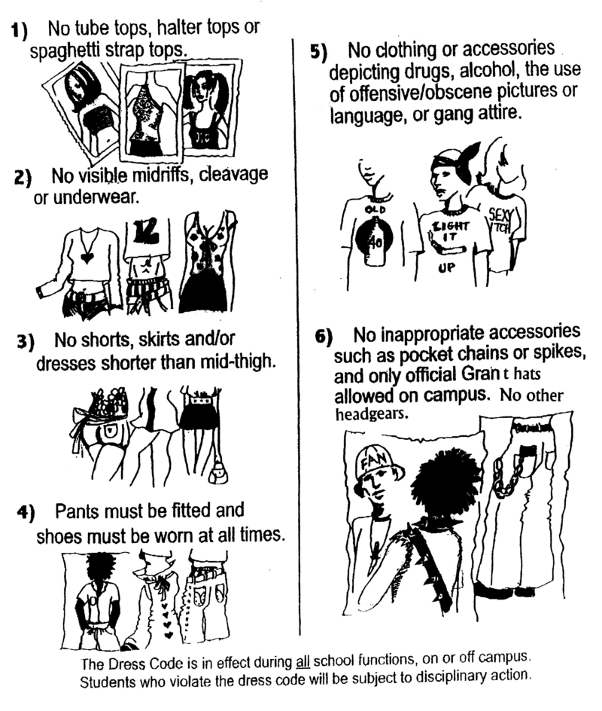
What is the difference?
School Uniforms are articles of clothing students
are required to wear to school.
Dress Codes are restrictions to what students are
allowed to wear in school.
Photo Credits: [School Uniforms] Wix.com retrived on 10/10/2014 from http://www.wix.com/blog/2013/09/school-uniform-through-time-and-space/
[Dress Codes] Granths.org retrieved on 10/10/2014 from http://granths.org/modules/groups/homepagefiles/cms/997756/Image/Images/Dress_code.jpg

Slide 11
Tinker v. Des Moines Independent Community School District (1969)
In this case, students sued the school for suspending them because they chose to wear black armbands to show their disapproval of the Vietnam War.
It was decided, Public Schools cannot “censor student expression – the wearing of black armbands, in that case – unless they could reasonably forecast that the student expression would cause substantial disruption or material interference with school activities or would invade the rights of others” (Hudson, 2012)
Both Proponents and Opponents to Dress Codes and Uniforms base their arguments on this case.
Proponents argue that dress codes and uniforms are a prevention of disruption in school, interference in learning and infringing on the rights of other students.
Opponents argue that dress codes and uniforms violate students freedom of expression and individuality.

Slide 12
What you need to know
Although not all courts or states handle dress codes and uniforms the same there are some generally accepted rules.
First, “within certain parameters, school officials can legally regulate students’ personal appearance” but only “if it is vulgar, indecent, obscene, insulting or if it carries a message that encourages inappropriate behavior” (“Schools…”, 2014)
Also, many schools may require TEACHERS to wear a uniform or adhere to a strict dress code. This, too, has caused many problems and has both Proponents and Opponents.
Proponents argue that dress codes and school uniforms:
Allow teachers to be “role models for their students” and “set a positive example through their attire” (“Schools…”, 2014)
Increases “employee morale” (“Schools…”, 2014)
Increases the students “respect for the profession” (“Schools…”, 2014)
Opponents argue that dress codes and school uniforms:
Treat teachers like students
“violate” freedom of expression in the First Amendment (“Schools…”, 2014)

Slide 13
Current Events
Leggings
School Shootings
Leggings have become a very popular fashion trend in recent years. Many schools have found leggings to be inappropriate for school and have included them in the Dress Code, claiming female students must wear shorts, skirts or a t-shirt that comes to their fingertips if they want to wear leggings.
Many schools claim that it is merely inappropriate dress for girls as they get older. Yet the enforcement of the Dress Code doesn’t seem to apply to all girls equally (The Associated Press, 2014).
Other school’s claim that leggings are “distracting to boys” (Bellaware, 2014). Many students and parents find that this “unfairly punishes girls” and “contribute[s] to rape culture” (Bellaware, 2014).
What do you think?
Due to “recent episodes of violence”, such as the school shootings at Sandy Hook Elementary, has “lead to an increasing interest in bringing uniforms and more stringent dress codes” into practice in public schools (“Schools…”, 2014)
Easier to identify trespassers who do not belong in the school
Limit the promotion of guns and arms
Certain codes make it easier to spot possible firearms on students (such as tucking in shirts)
What do you think?

Slide 14
References
Bellware, K. (2014, March 19). Parents Say School's Leggings 'Ban' Is Unfair To Girls, 'Contributes To Rape Culture‘. The Huffington Post. Retrieved from http://www.huffingtonpost.com/2014/03/19/school-bans-leggings_n_4993941.html
(2014). Does the First Amendment Apply to Public Schools? First Amendment Center. Retrieved from http://www.firstamendmentschools.org/freedoms/faq.aspx?id=12807.
Legal Information Institute (2014) . First Amendment. Cornell University. Retrieved from http://www.law.cornell.edu/wex/first_amendment.
Hudson, David L., Jr. (2012). Clothing, Dress Codes & Uniforms. First Amendment Center. http://www.firstamendmentcenter.org/clothing-dress-codes-uniforms
(2014). Notable First Amendment Court Cases. American Library Association. Retrieved from http://www.ala.org/advocacy/intfreedom/censorshipfirstamendmentissues/courtcases
(2014). School Safety: Uniforms/Dress Codes. Education Commission of the States. Retrieved from http://www.ecs.org/html/IssueSection.asp?issueid=101&subissueid=331&s=Overview
The Associated Press. (2014). Leggings in the Classroom Banned by Illinois School Dress Code. WJLA. ABC7. Retrieved from http://www.wjla.com/articles/2014/04/leggings-in-the-classroom-banned-by-illinois-school-dress-code-102192.html

